Slide 1
Wine Quality Prediction with Machine Learning
By
Kajal Kumar Ghosh
Email: kkgcom@gmail.com

Slide 2
For this project, I used Wine Quality dataset to build various classification models to predict whether a particular wine is “good quality” or not. Each wine in this dataset is given a “quality” score between 0 and 10. For the purpose of this project, I converted the output to a binary output where each wine is either “good quality” (a score of 7 or higher) or not (a score below 7). The quality of a wine is determined by 11 input variables:
Fixed acidity
Volatile acidity
Citric acid
Residual sugar
Chlorides
Free sulfur dioxide
Total sulfur dioxide
Density
pH
Sulfates
Alcohol

Slide 3
Objectives:
The objectives of this project are as follows
1. Our Main objective is to predict the wine quality using Machine Learning through Python programming language.
2. To experiment with different classification methods to see which yields the highest accuracy.
3. To determine which features are the most indicative of a good quality wine.
4. Output obtained would further be checked for correctness and model will be optimized accordingly.

Slide 4
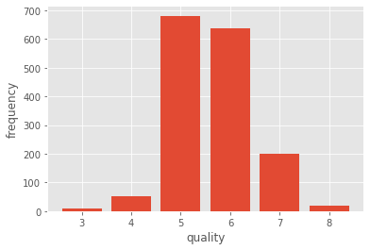
Quality type frequencies

Slide 5
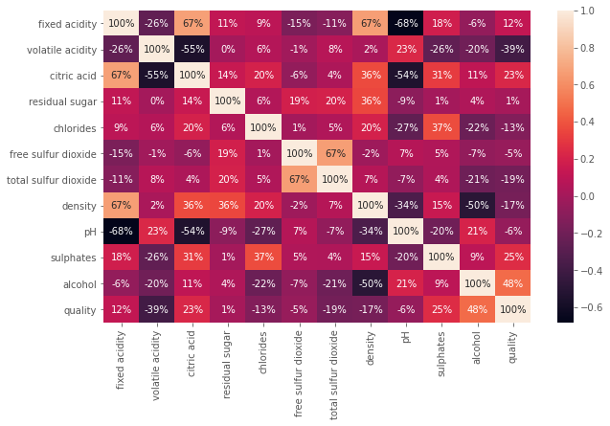
Heatmap to plot all correlations between features

Slide 6
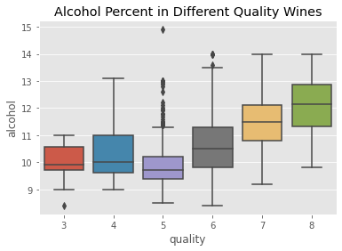
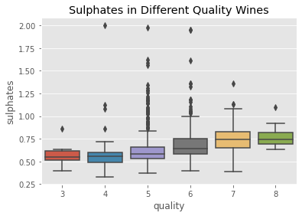
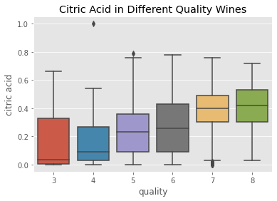
Visualization of features:

Slide 7
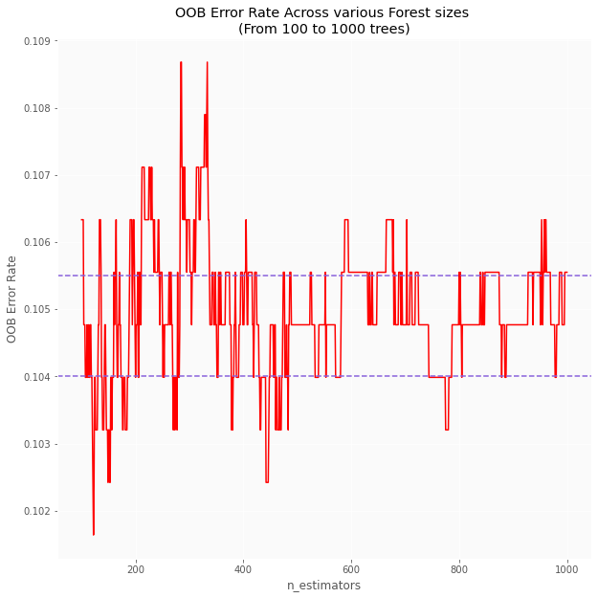
OOB Error Rate

Slide 8
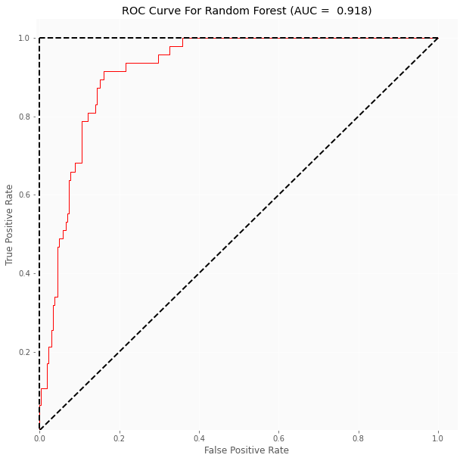
ROC Curve for Random Forest:

Slide 9
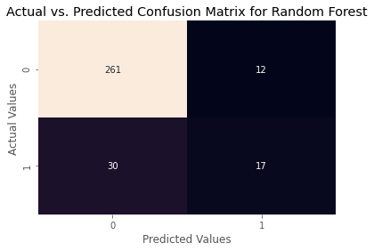
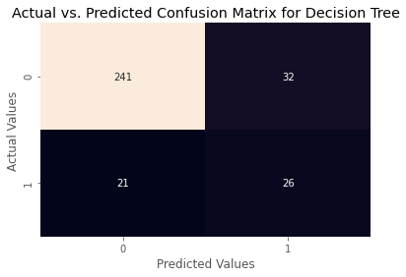
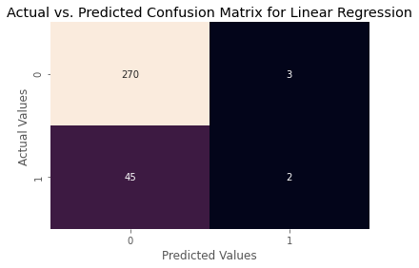
Confusion matrix for Random Forest, Decision Tree and Linear Regression Algorithm.

Slide 10
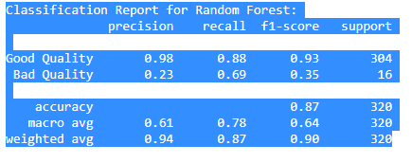
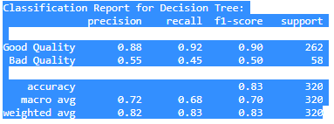
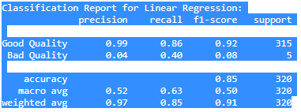
Classification Report for Random Forest, Decision Tree and Linear Regression:
Our accuracy on the test set (with 80%-20% train test ratio with Random Forest: 0.869
The quality of the wines are in the set {3,4,5,6,7,8} . We want to classify the wine into so-called 'bad' and 'good'. We study statistics of our dataset to determine how to make a classification.
we classify wine as 'poor' if quality is less then or equal to 6 , otherwise we classify the wine as 'good'. We replace the column quality with the value 0 for 'poor' wine and the value 1 for 'good' wine.

Slide 11
RMSE calculations:
Random Forest Regression RMSE: 0.362284418654736
Decision Tree Regressor RMSE: 0.40697051490249264
Random Forest Regression RMSE: 0.362284418654736
When deciding which regression algorithm is better by looking at RMSE we would better choose the one with smaller value, so for this problem, Random Forest Regression seems to be the best fitting algorithm.

Slide 12
Conclusion:
By looking into the details, we can see that good quality wines have higher levels of alcohol on average, have a lower volatile acidity on average, higher levels of sulphates on average, and higher levels of residual sugar on average.
The vast majority of wines get a quality rating of five or six, while having good and bad wines seems more unlikely. There seem not to be any excellent wines (>8) on this database.
From the very first moment we saw there weren't strong correlations between features and quality, that's why it's hard to make an accurate prediction using regression algorithms. That said, alcohol, sulphates, citric acid features are the ones that correlate the most positively while volatile acidity is the one correlating the most negatively.
Random Forest, Decision and Linear Regression all seem to be the best fitting models when solving this problem using regression.
Applying the concept 1-off Accuracy gives us much better results.

